Slide 1
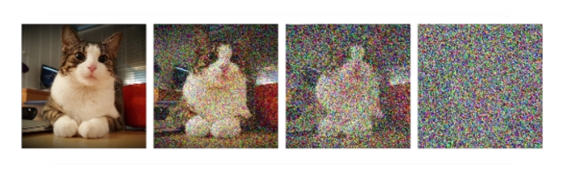
Diffusion Model
&
Guidance
Created by:
Chris, Sam, and Caleb
Notes:
30s

Slide 2
01 Intro
02 Background
03 Motivation
04 Methodology
05 Experiments
06 Conclusion
Content
Part A: 20 mins
Part B: 5 mins
Introduction
Background
Caleb
Questions
Motivation
Methodology
Sam
Experiments
Conclusion
Chris
Notes:
10s

Slide 3
01 Intro
02 Background
03 Motivation
04 Methodology
05 Experiments
06 Conclusion
Introduction
Diffusion models: generate high-quality samples
Problem: controlling the generation is challenging
Goal: generate a specific classes/satisfy certain preferences
Solution: guided generation (i.e. density-ratio guidance)
Notes:
1 min

Slide 4
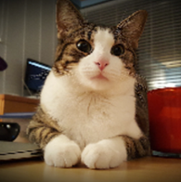

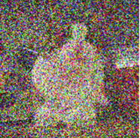

01 Intro
02 Background
03 Motivation
04 Methodology
05 Experiments
06 Conclusion
Background: Diffusion model
Forward process: Adding noise to a real image until it becomes pure noise
Backward process: Train a neural network to gradually remove the noise
Forward process
Backward process
Notes:
1 min

Slide 5



Sampling
01 Intro
02 Background
03 Motivation
04 Methodology
05 Experiments
06 Conclusion
Training
Train the neural network to minimize the average error between the actual and predicted noise
Using the trained model, we can sample from the data distribution
$$x_{t}=\sqrt{\overline{α_{t}}} x_{0} \text{+ } \sqrt{1−\overline{α_{t}}}ε$$
Clean image
Added noise
$$x_{t−1} = μ_{θ}\left(x_{t},t\right) +σ_{t}z$$
Trained Model
$${}_{θ}^{min}{E_{x_{0},ε}[{ \left|\left|ε− ε_{θ}\left(x_{t},t\right)\right|\right|}^{2}] }$$
Predicted noise
Notes:
1.5 min

Slide 6

01 Intro
02 Background
03 Motivation
04 Methodology
05 Experiments
06 Conclusion
Diffusion Model Sampling
MNIST Dataset
Notes:
30 seconds

Slide 7
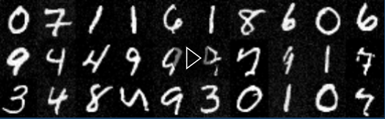
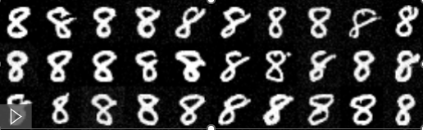
01 Intro
02 Background
03 Motivation
04 Methodology
05 Experiments
06 Conclusion
Motivation
Limitation:
  Controllability: Unconditional models cannot generate samples with specific classes (e.g. number 8) or properties within the distribution they were trained on
Solution:
  Guided generation by modifying sampling without retraining the model
Notes:
30 seconds

Slide 8
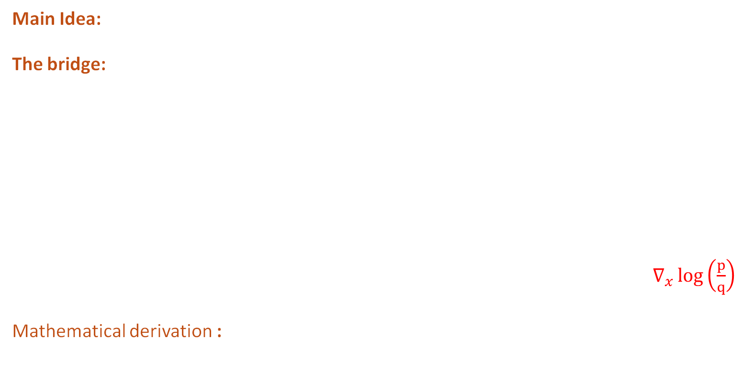
01 Intro
02 Background
03 Motivation
04 Methodology
05 Experiments
06 Conclusion
Methodology: Guidance
Main Idea: Guided generation by modifying sampling without retraining the model
The bridge:
  Diffusion model (DDPM) sampling term $x_{t−1} = μ_{θ}\left(x_{t},t\right) +σ_{t}z$
  Guidance term $∇_{x_{t}}\log\left(\frac{p}{q}\right)$
  Guided sampling formula $x_{t−1}= μ_{θ}\left(x_{t},t \right)+σ_{t}z + β_{t} ∇_{x}\log\left(\frac{p}{q}\right)$
Mathematical derivation :
  Song et al. (2021) in Appendix 3
DDPM sampling term guidance term
Notes:
1 min

Slide 9
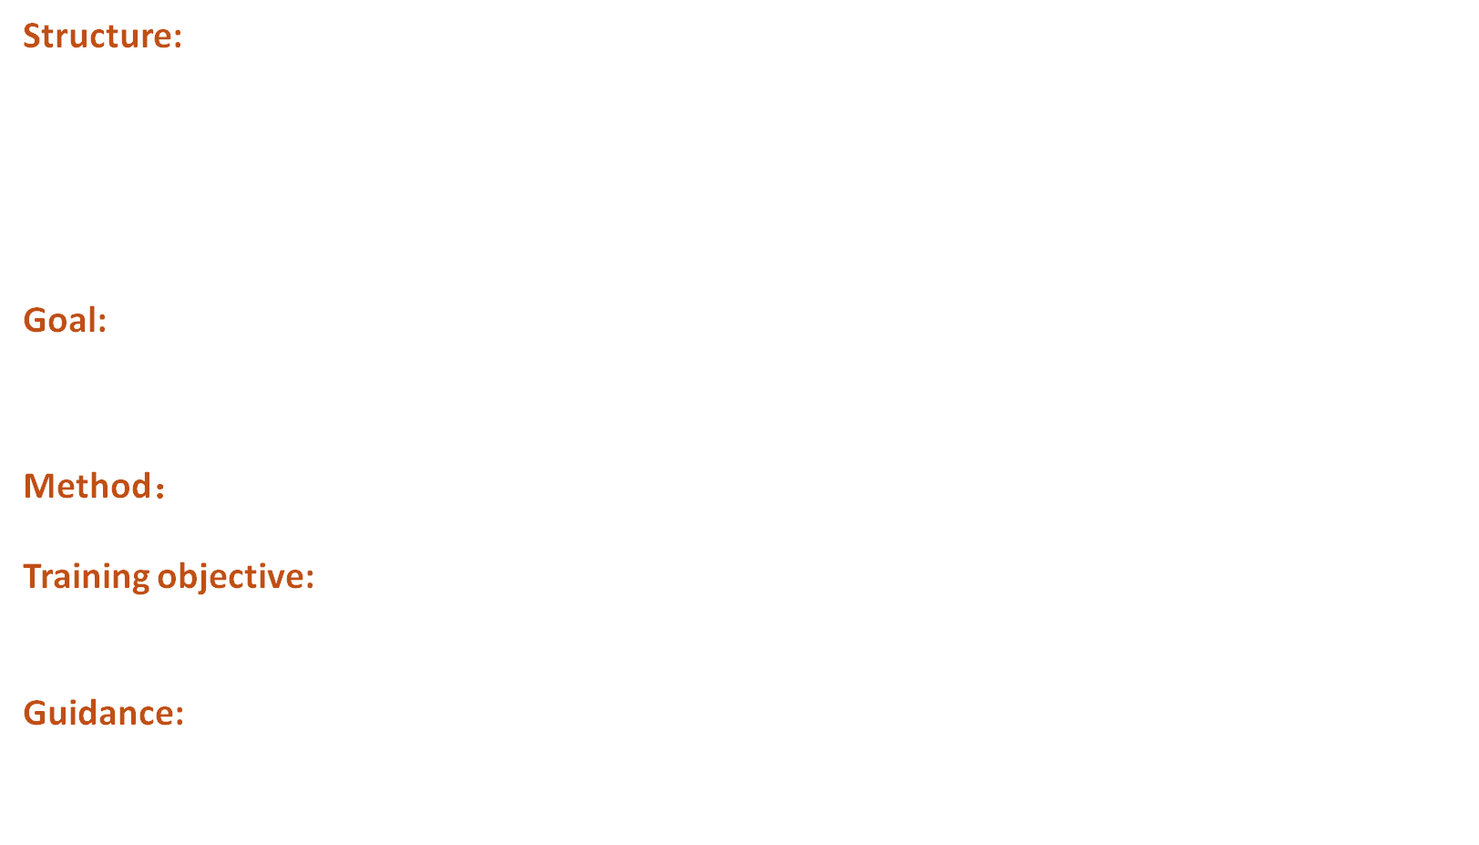
01 Intro
02 Background
03 Motivation
04 Methodology
05 Experiments
06 Conclusion
Methodology: Density Ratio Guidance
Structure:
$$x_{t−1}= μ_{θ}\left(x_{t},t \right)+σ_{t}z + g ∙ β_{t} ∇_{x}\log\left(\frac{p}{q}\right)$$
Goal: Estimate by logistic regression (MLP)
          $f_{θ}\left(x\right)=\log{r\left(x\right)}=\log{\frac{p\left(x\right)}{q(x)}}$
Method： logistic regression (MLP)
Training objective:
          $Loss = BCEWithLogitsLoss(f_{θ}\left(x\right)，y)$
Guidance:
          $x_{t−1}=DDPM step+ g ∙ β_{t}{ ∇}_{x}\log{r\left(x\right)}$
Density ratio: $r=\frac{p}{q}$ p: target distribution q: non-target distribution
DDPM sampling term guidance term

Slide 10

01 Intro
02 Background
03 Motivation
04 Methodology
05 Experiments
06 Conclusion
Diffusion Model Sampling
Without guidance
Density ratio guidance to 8

Slide 11
01 Intro
02 Background
03 Motivation
04 Methodology
05 Experiments
06 Conclusion
Experiments
  Experiment 1： Toy dataset (2D Gaussian)
  Experiment 2： Image dataset (MNIST numbers)

Slide 12
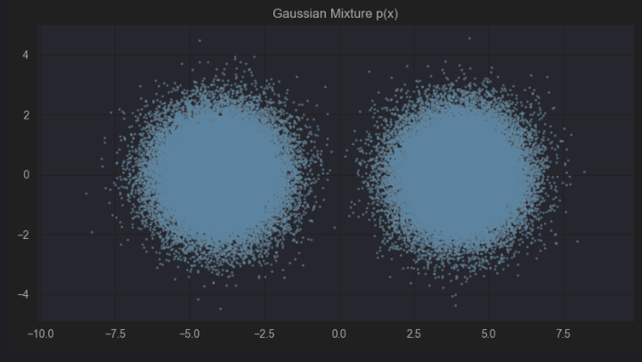
01 Intro
02 Background
03 Motivation
04 Methodology
05 Experiments
06 Conclusion
Experiments
  Toy dataset (2D Gaussian)

Slide 13
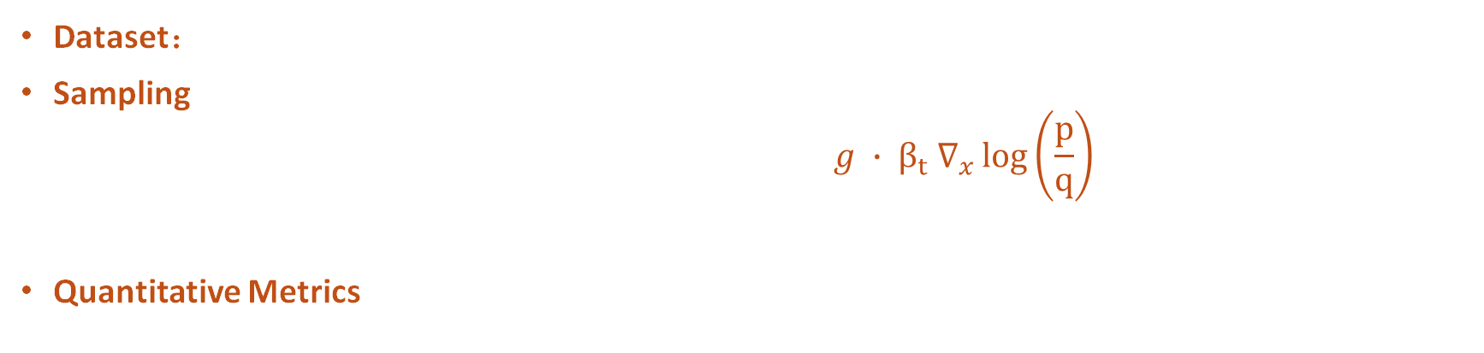
01 Intro
02 Background
03 Motivation
04 Methodology
05 Experiments
06 Conclusion
Experiment Setting
Dataset： 2D Gaussian mixture
Sampling：Density ratio guidance
$$x_{t−1}= μ_{θ}\left(x_{t},t \right)+σ_{t}z + g ∙ β_{t} ∇_{x}\log\left(\frac{p}{q}\right)$$
Quantitative Metrics
DDPM sampling term guidance term
Sampling side
Higher, better
Training side
Coverage (real→gen)： how many real data are covered by generated data
Coverage (gen→real)： how many generated data fall inside real distribution
MMD²： The difference between the generated and real distribution
Average loss
Lower, better
Lower, better

Slide 14
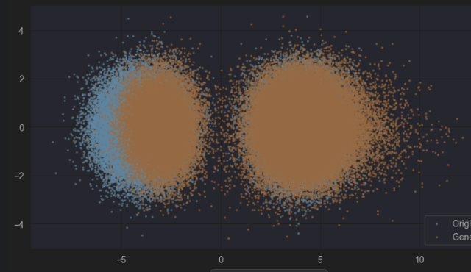
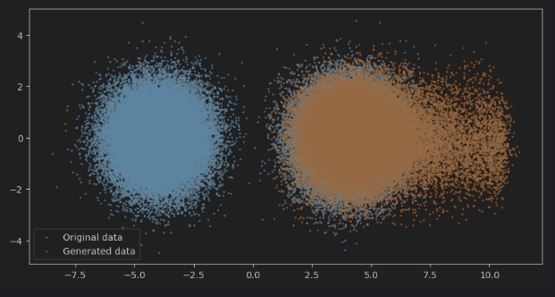
01 Intro
02 Background
03 Motivation
04 Methodology
05 Experiments
06 Conclusion
Experiment Results
  Without guidance
  Guided generation targeting right distribution

Slide 15
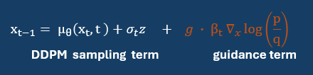
01 Intro
02 Background
03 Motivation
04 Methodology
05 Experiments
06 Conclusion
Experiment Results
DDPM | Guidance scale g = 0 | Guidance scale g = 1
Coverage (real→gen) | 0.821 | 0.959 ( + 16.6% )
Coverage (gen→real) | 0.872 | 0.859 ( - 0.01% )
MMD² | 0.053 | 0.015 ( - 71% )
96% real data are covered generated data
86 % generated data fall into real distribution
Even lower distribution difference

Slide 16
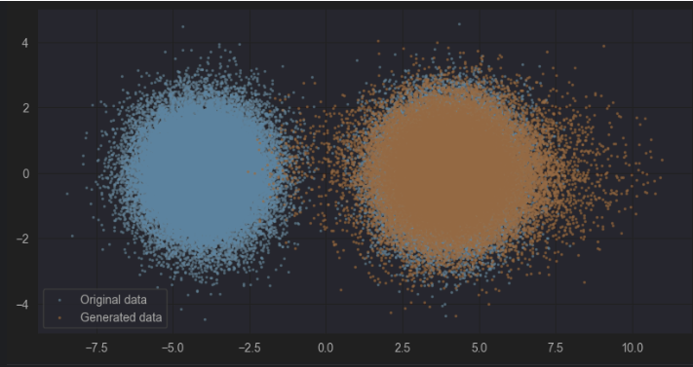
01 Intro
02 Background
03 Motivation
04 Methodology
05 Experiments
06 Conclusion
Experiment Results
Guidance scale g = 1
Guidance scale g = 0.4

Slide 17
01 Intro
02 Background
03 Motivation
04 Methodology
05 Experiments
06 Conclusion
Experiment Results
DDPM | Guidance scale g = 0 | Guidance scale g = 1 | Guidance scale g = 0.4
Coverage (real→gen) | 0.821 | 0.959 ( + 16.6% ) | 0.965 ( + 17.5% )
Coverage (gen→real) | 0.872 | 0.859 ( - 0.01% ) | 0.920 ( + 5% )
MMD² | 0.053 | 0.015 ( - 71% ) | 0.0029 ( - 94% )
Higher, better
17% more real data are covered
5 % more gen data fall into real distribution
94% reduced distribution difference
Lower, better

Slide 18
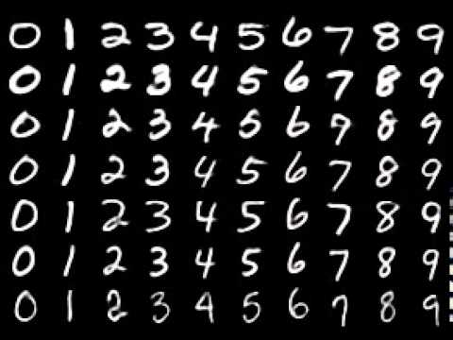
01 Intro
02 Background
03 Motivation
04 Methodology
05 Experiments
06 Conclusion
  Image dataset (MNIST numbers)

Slide 19
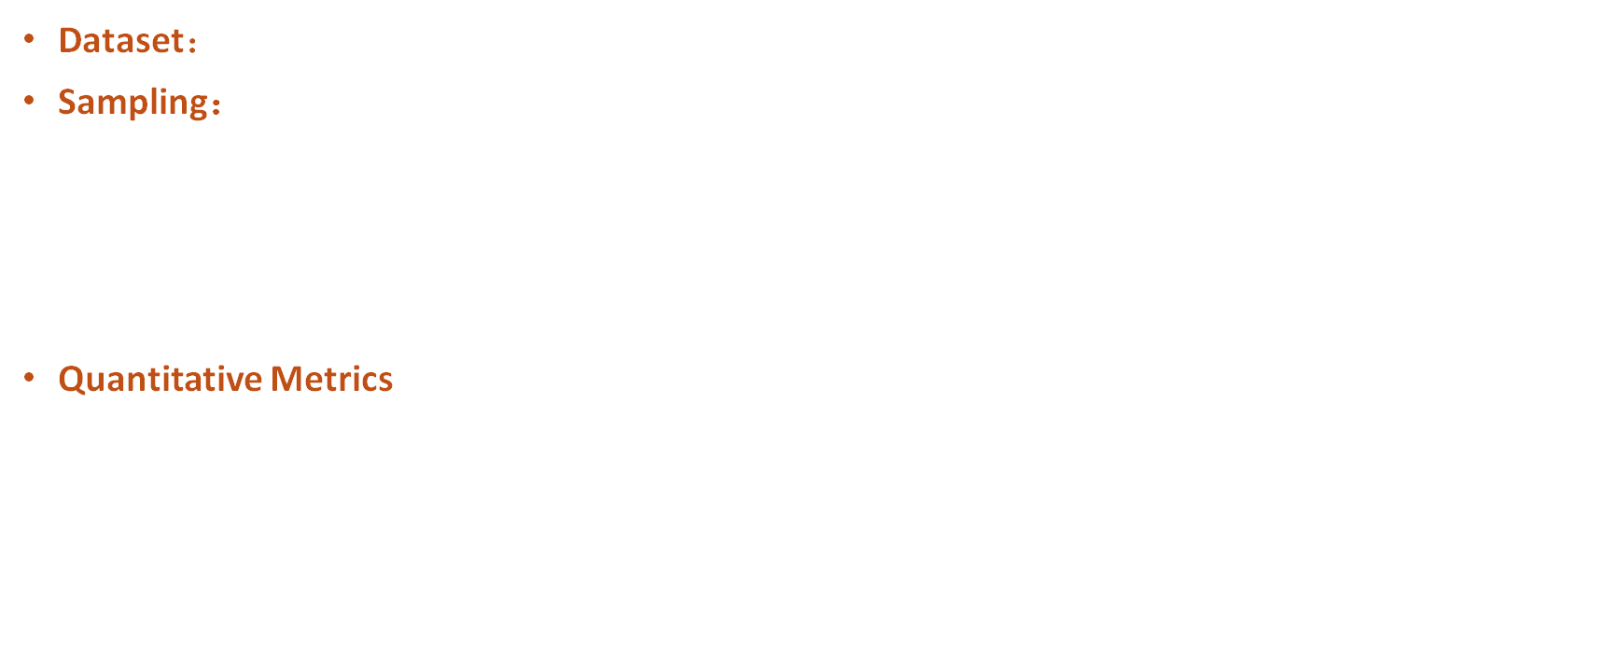
01 Intro
02 Background
03 Motivation
04 Methodology
05 Experiments
06 Conclusion
Experiment Setting
Dataset： MNIST
Sampling：Density ratio guidance
$$x_{t−1}= μ_{θ}\left(x_{t},t \right)+σ_{t}z + g ∙ β_{t} ∇_{x}\log\left(\frac{p}{q}\right)$$
Quantitative Metrics
DDPM sampling term guidance term
    Coverage (Gen→real)
    Coverage (Real→Gen)
    Precision: how many generated data fall inside real distribution
    Recall: how many real data are covered by generated data
Accuracy
Diversity
Lower, better

Slide 20
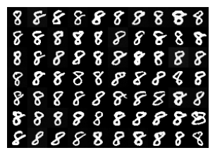
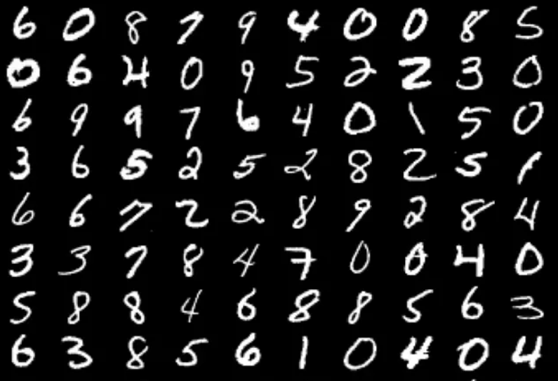
01 Intro
02 Background
03 Motivation
04 Methodology
05 Experiments
06 Conclusion
Experiment Results
Without Guidance
  Guided generation targeting number 8

Slide 21
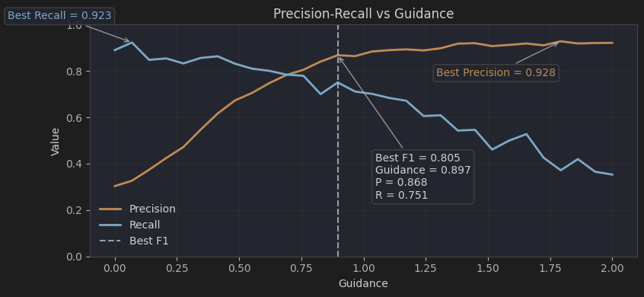

01 Intro
02 Background
03 Motivation
04 Methodology
05 Experiments
06 Conclusion
Experiment Results
$$x_{t−1}= μ_{θ}\left(x_{t},t \right)+σ_{t}z + g ∙ β_{t} ∇_{x}\log\left(\frac{p}{q}\right)$$
DDPM sampling term guidance term
Precision peaks at 0.93
Recall peaks at 0.92
F1 peaks at 0.81
As guidance g increases:
  Precision increases
  Recall decreases

Slide 22
01 Intro
02 Background
03 Motivation
04 Methodology
05 Experiments
06 Conclusion
Experiment Results
$$x_{t−1}= μ_{θ}\left(x_{t},t \right)+σ_{t}z + g ∙ β_{t} ∇_{x}\log\left(\frac{p}{q}\right)$$
DDPM sampling term guidance term
We choose the guidance strength that best balances the precision
and recall
For g = 0.9
87% generated date fall inside the real distribution
75% real data are covered by generated data

Slide 23
01 Intro
02 Background
03 Motivation
04 Methodology
05 Experiments
06 Conclusion
Conclusion
Pros:
  Controllability: Control sampling process using density ratio guidance
  Scalability: Performs on simple and complex dataset
Cons:
  Flexibility: Sampling towards new distribution requires retraining the classifier
  Optimisation: You must optimise the guidance weight to balance the quality and diversity
Pros
Cons
Future
Compare with other guidance techniques like classifier guidance
Further the mathematical foundations, especially in optimisation.

Slide 24
Thank you for your time!
Any questions?

